Slide 1
Building Our Energy Future
Prof. James W. Coleman  @EnergyLawProf

Slide 2
Today
Global Shifts to Electricity & Renewables
Securing New Supply Chains
Infrastructure Funding & Roadblocks

Slide 3
Global Shifts to Electricity & Renewables

Slide 4
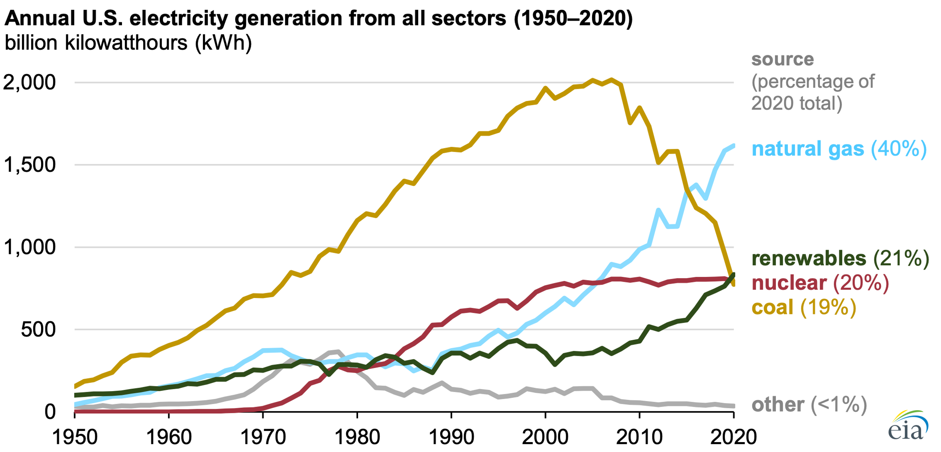

Slide 5
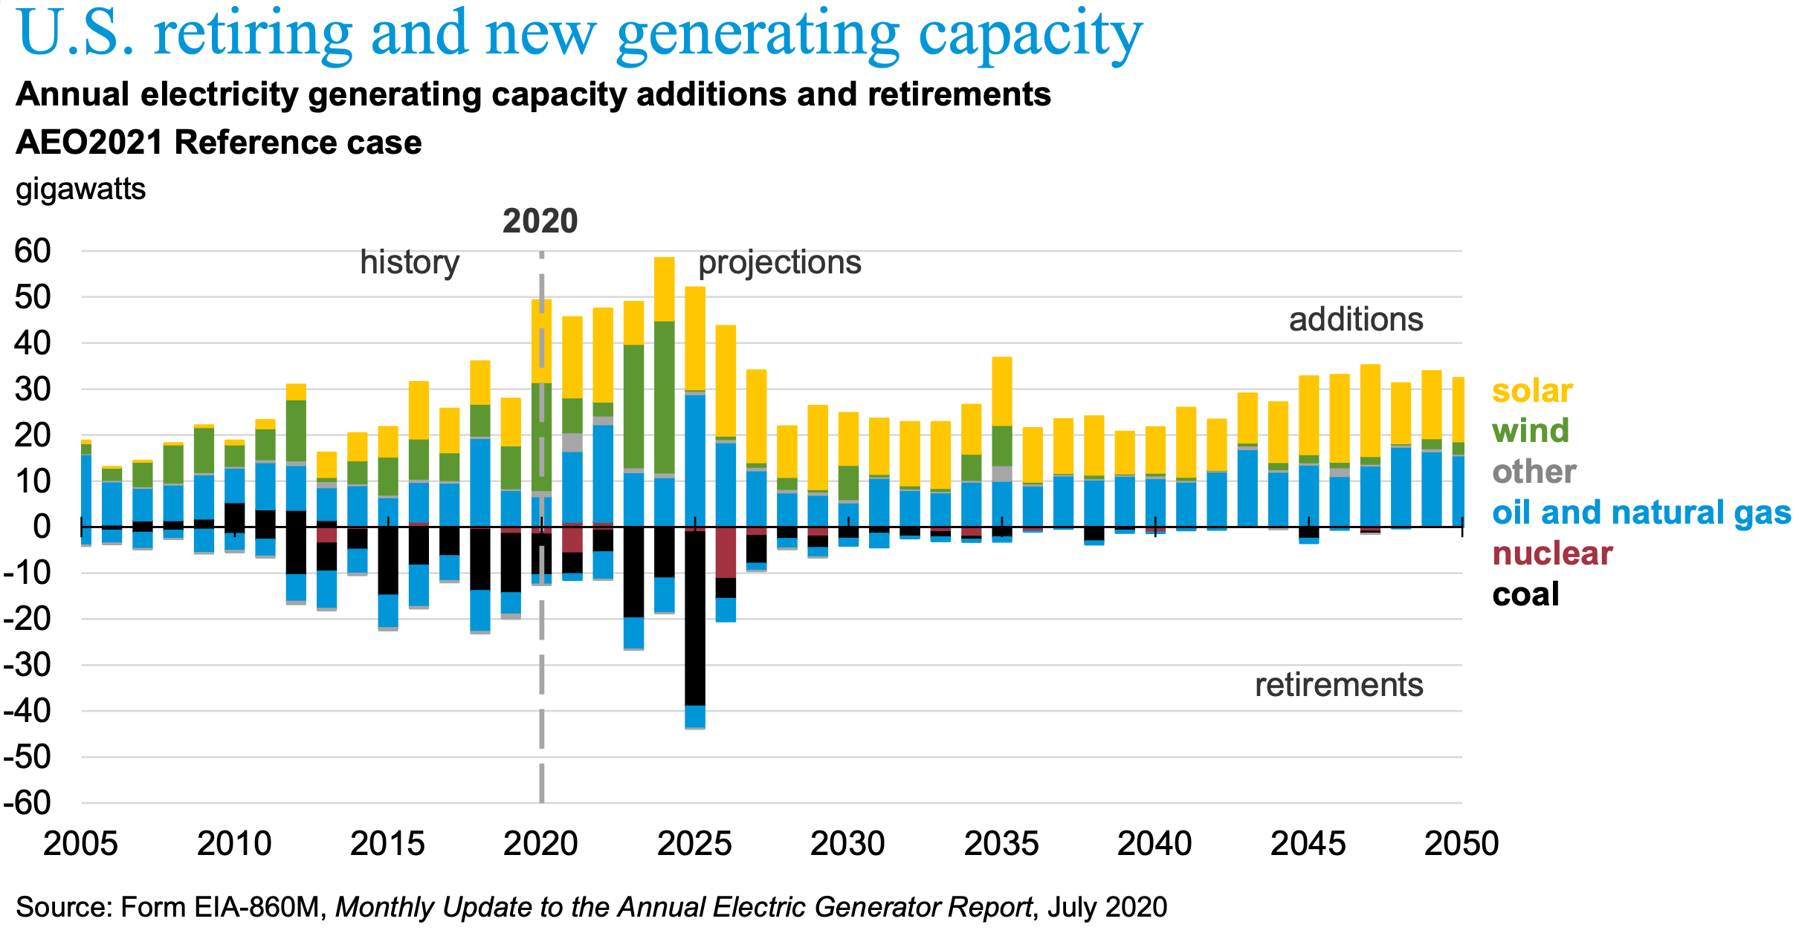

Slide 6
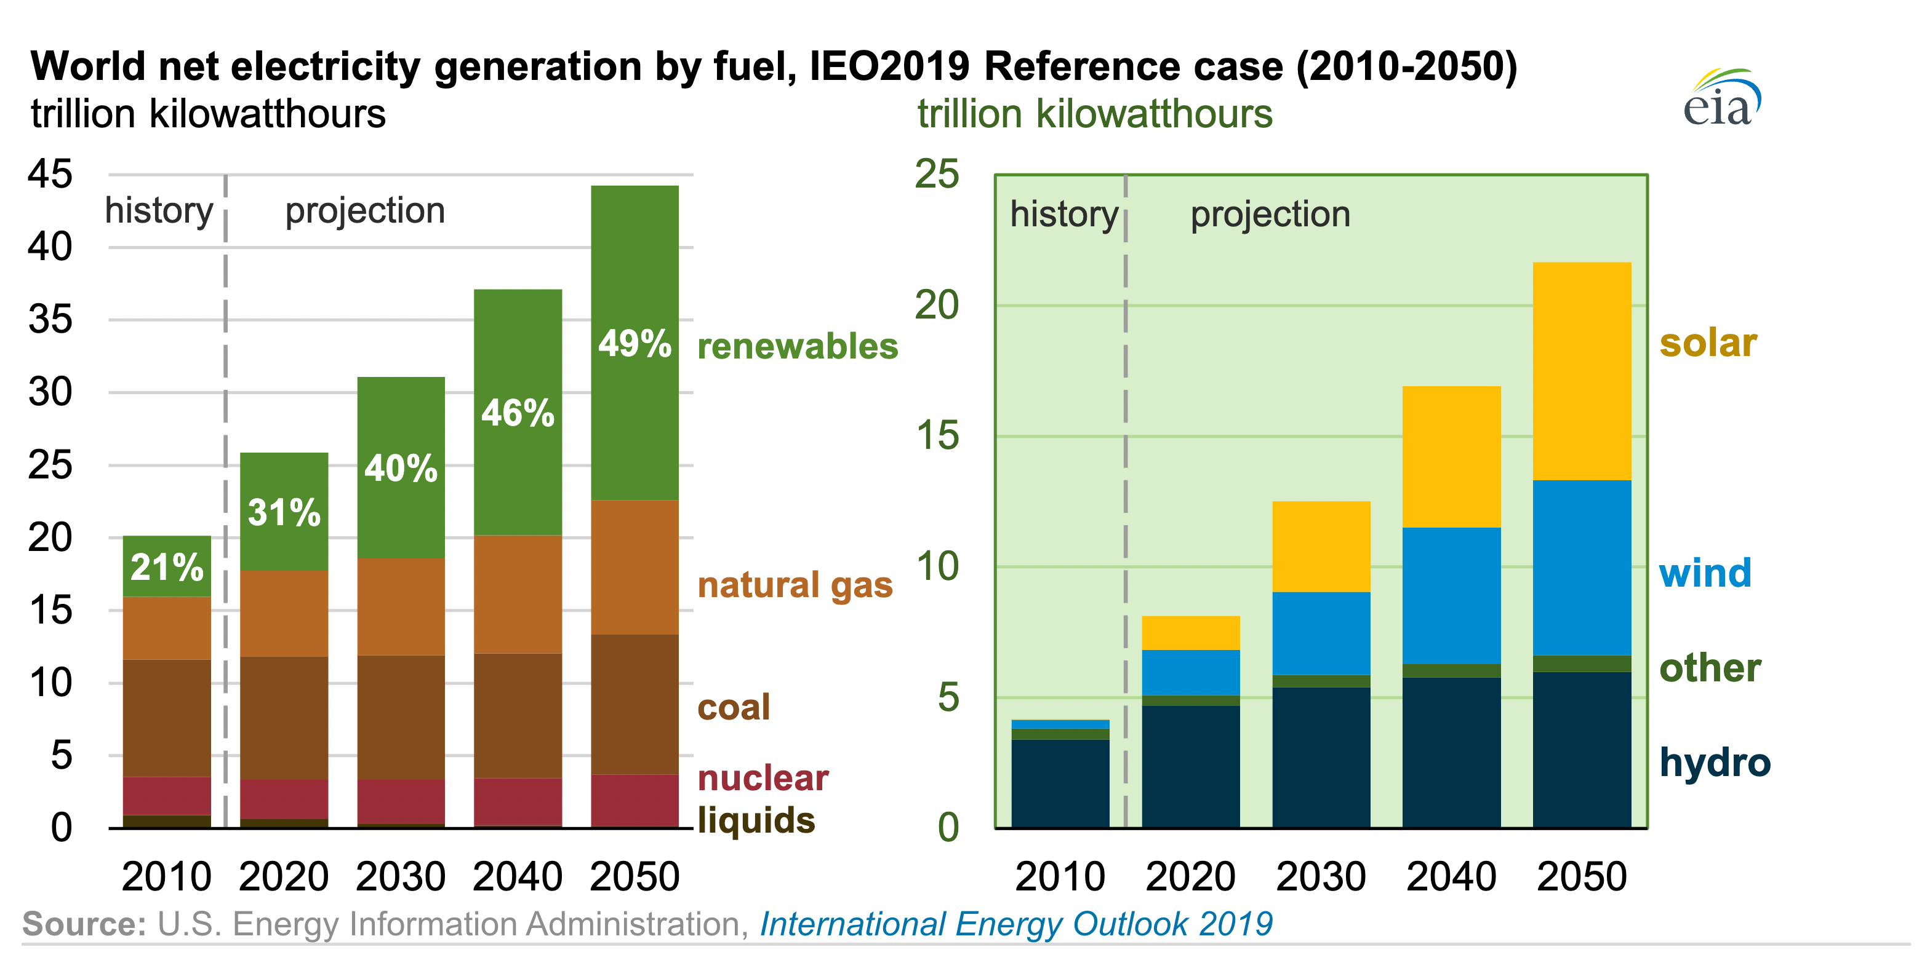
Similar Expectations for World Power
Notes:
Norway-UK treaties govern Frigg (1976); Statfjord (1979); & Murchison (1979).
Also UK-Netherlands treaty for Markham Field.
Norway-UK general unitization framework treaty in 2005. (intended to avoid the need for new treaties)
Provides process for allocating unit production between UK and Norway and a general unit plan in consultation with licensees
Then licensees make a UA and designate a UO and then UK and Norway must approve
Expert referral

Slide 7
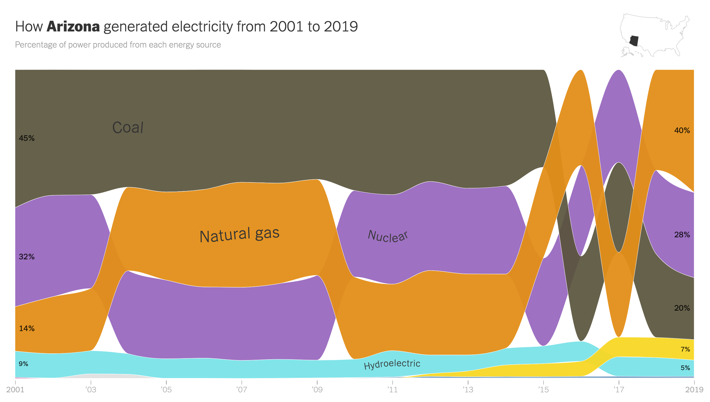

Slide 9
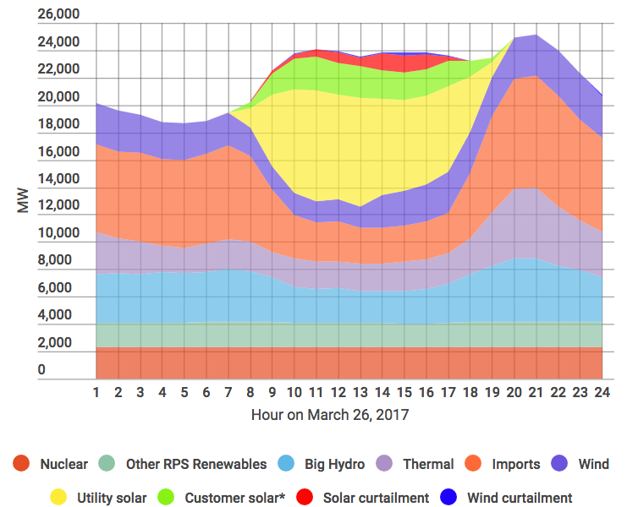
Grid Must Always Balance: Renewables Save Fuel But May Not Be There

Slide 10
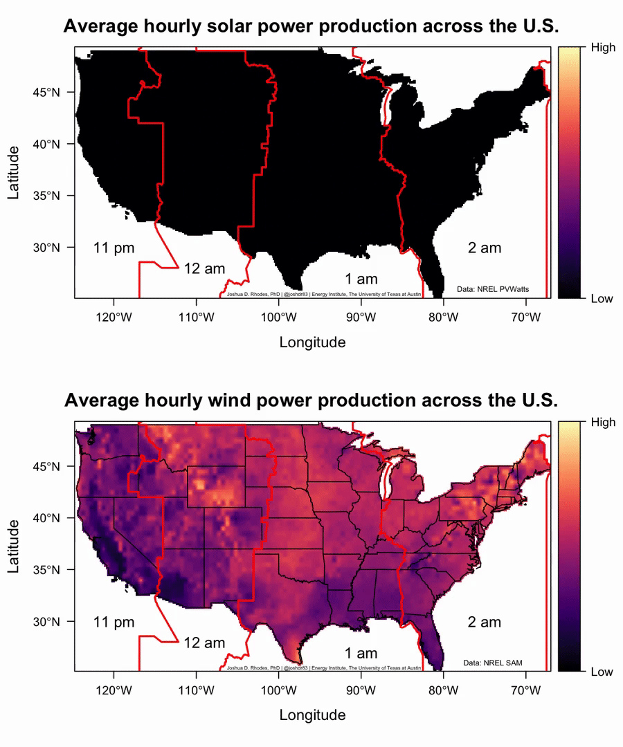
Wind & solar power vary over the day… Neither is particularly strong during peak power consumption (early evening)
Notes:
When you work in the oil industry, you’ll find that many of your problems cannot be solved with engineering, or market analysis, or customer relations—they’ll depend on government regulation.

Slide 11
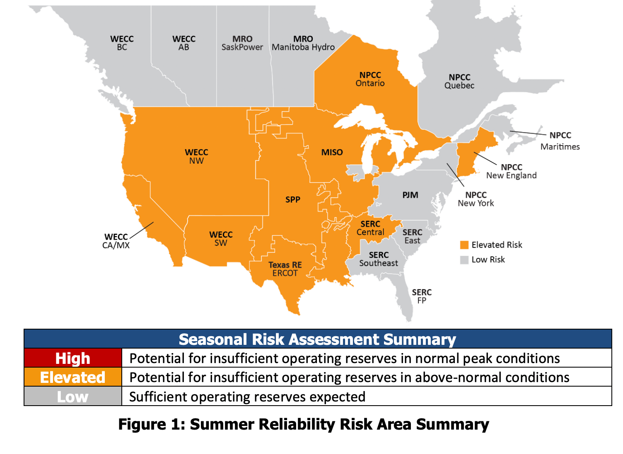

Slide 12
Securing New Supply Chains

Slide 13
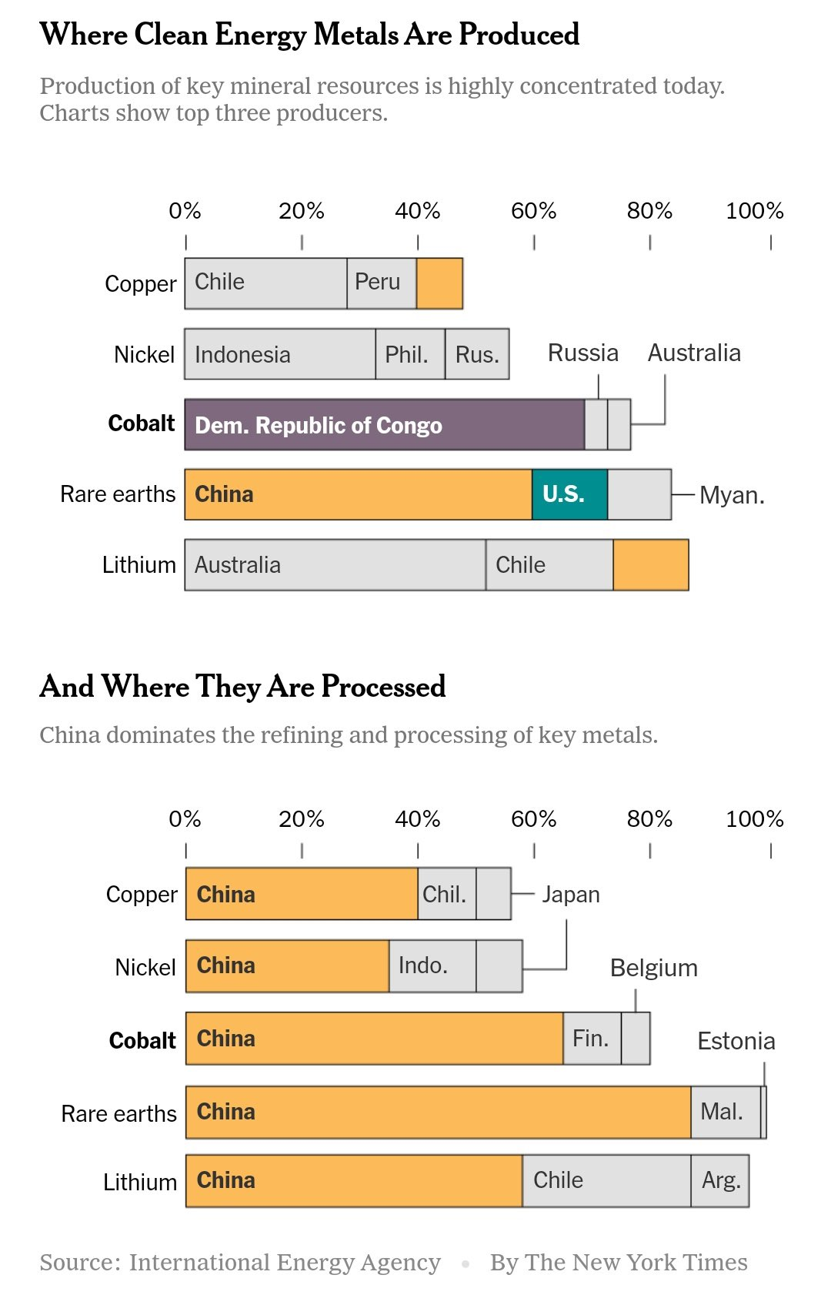
Building New Supply Chains
U.S. is #1 global producer of both oil and gas
U.S. is not in top 10 producers of most important commodities for transition, such as cobalt & lithium
How much can we produce in United States and how much can we friend-source?

Slide 14
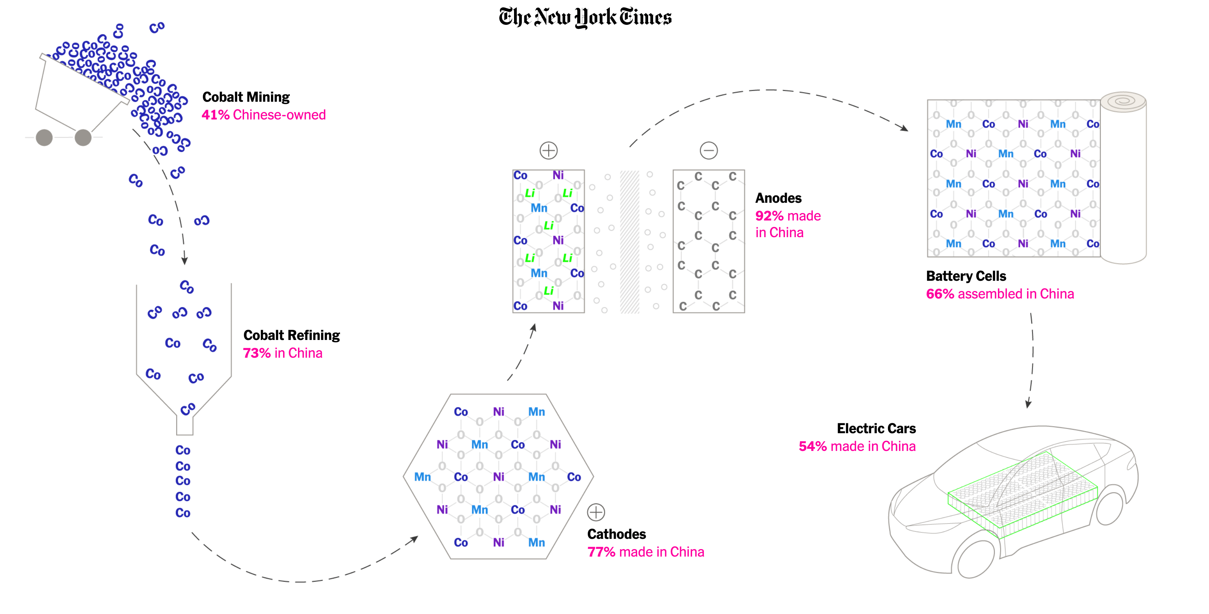

Slide 15
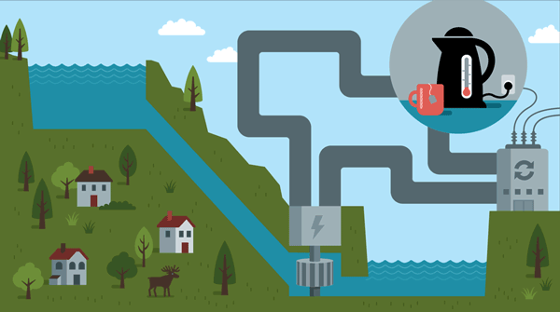
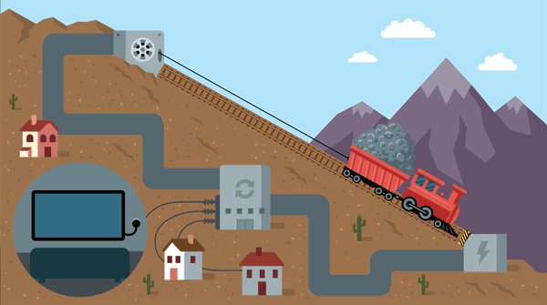
Transformative Technologies?
New forms of electricity storage?
New demand response?
New battery chemistries?
Low-carbon natural gas exports?

Slide 16
Infrastructure Funding & Roadblocks

Slide 17
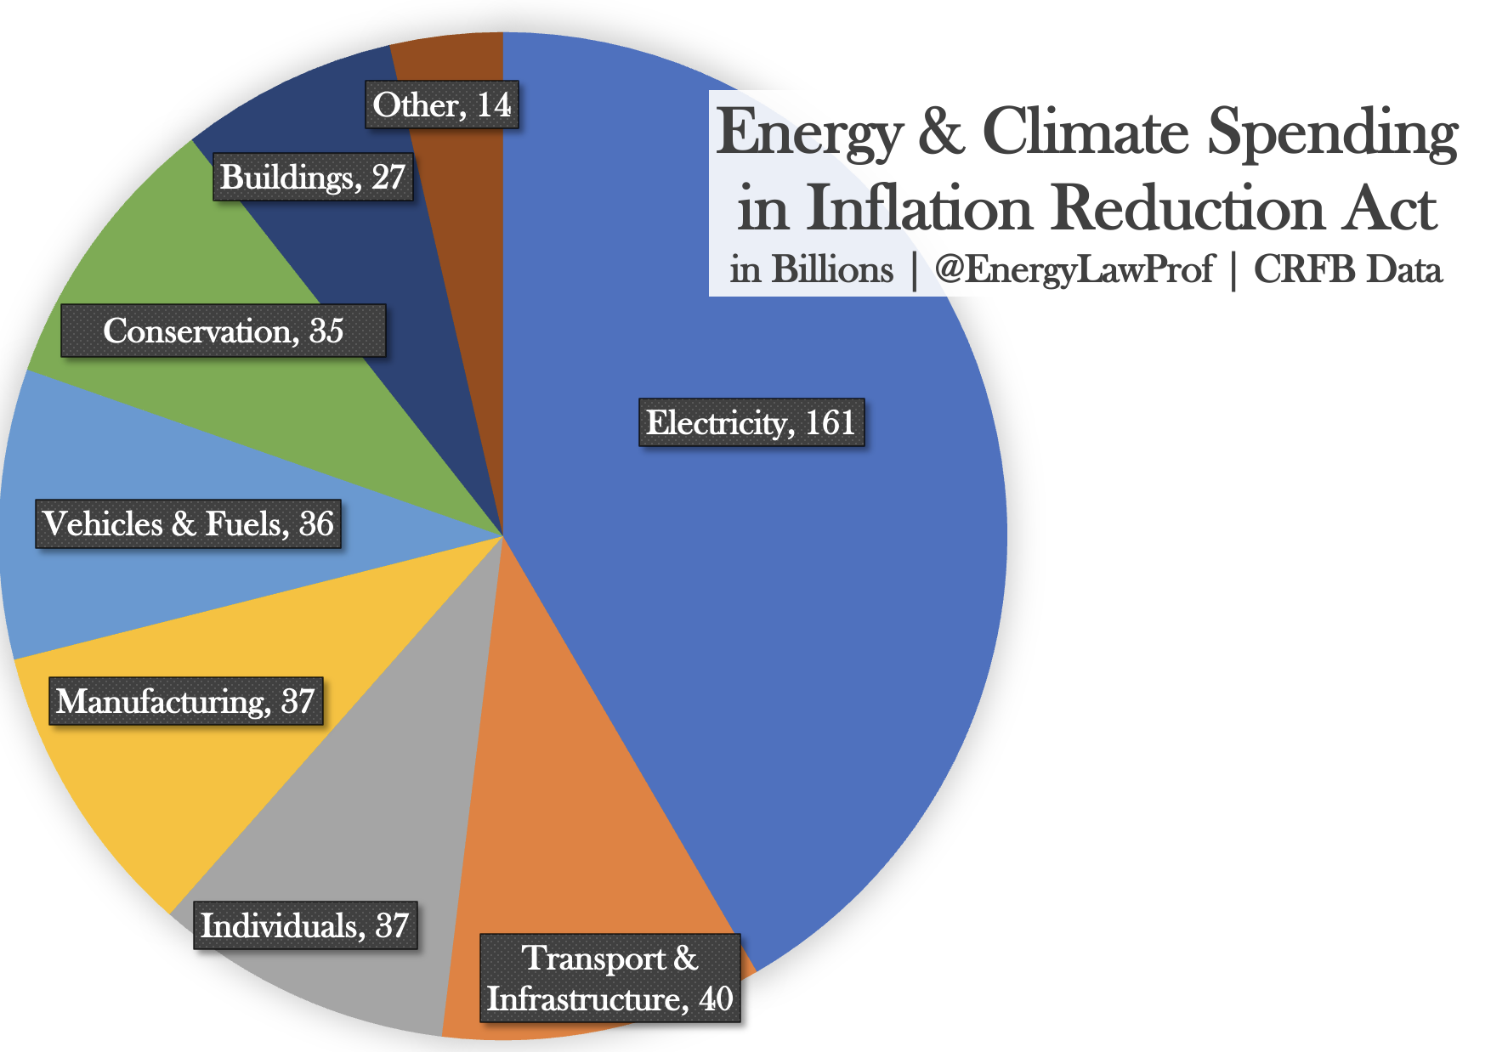

Slide 20
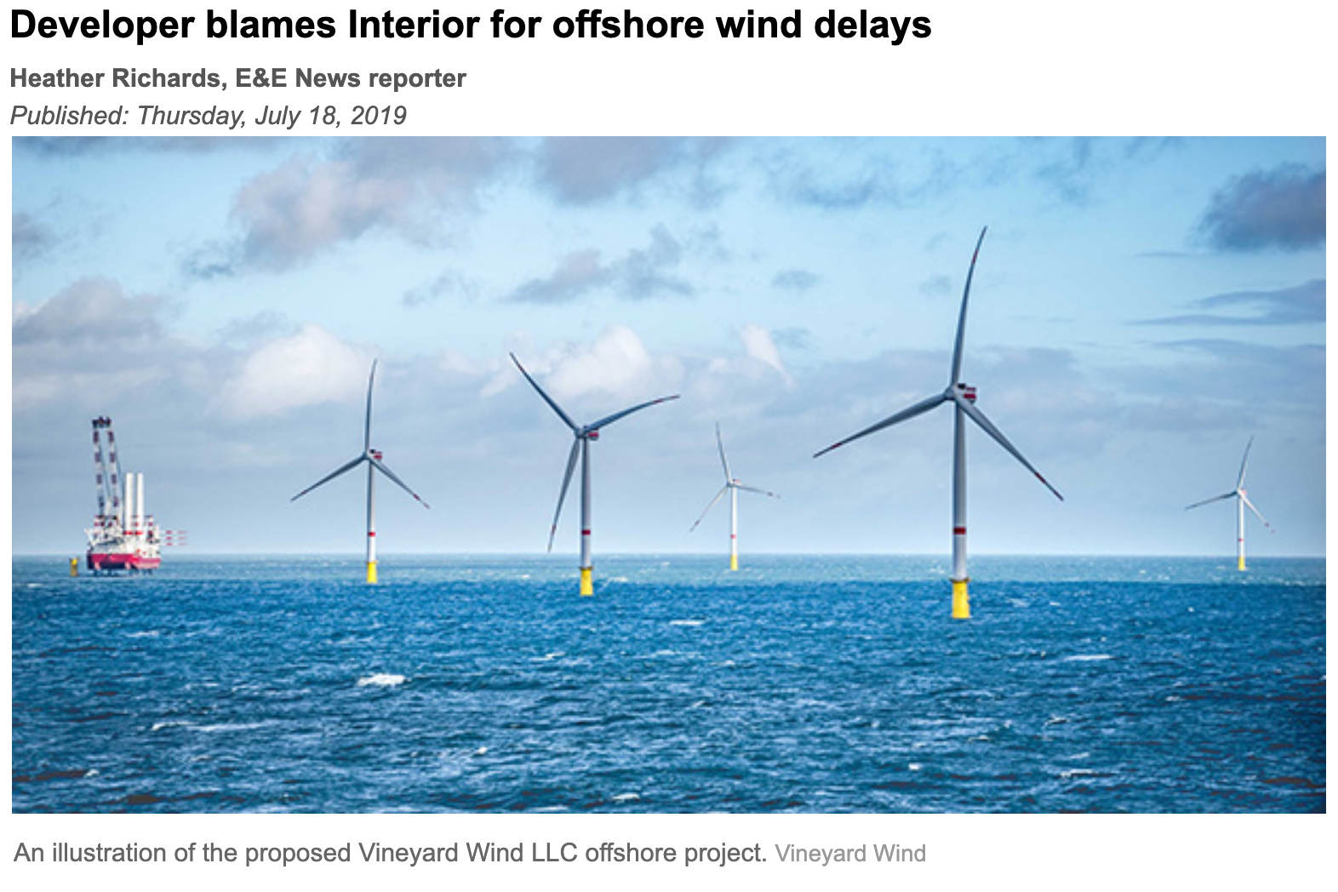
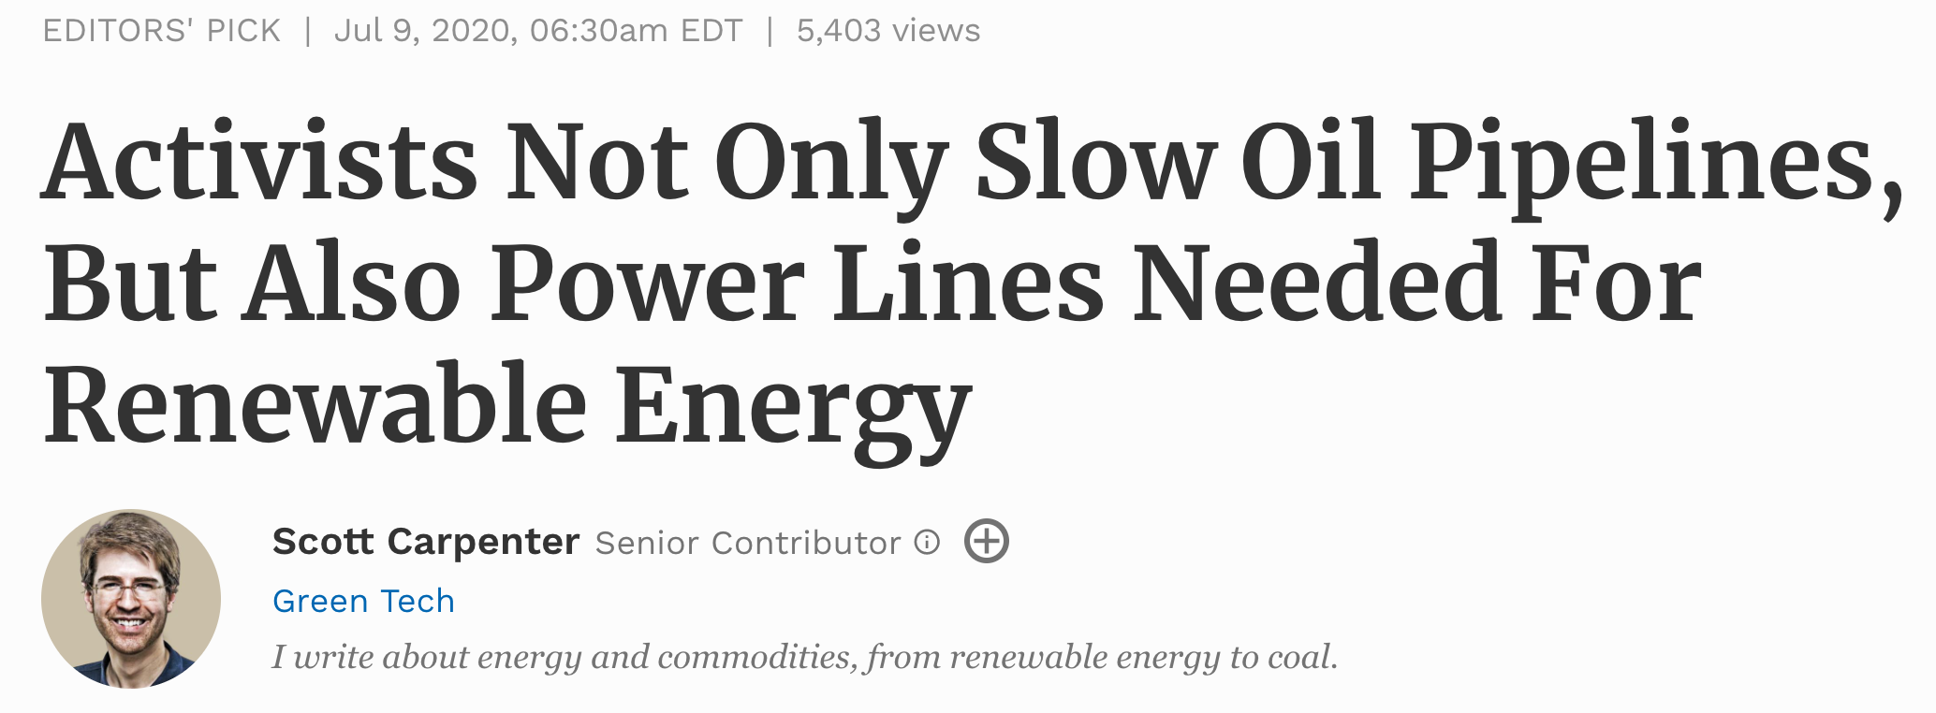
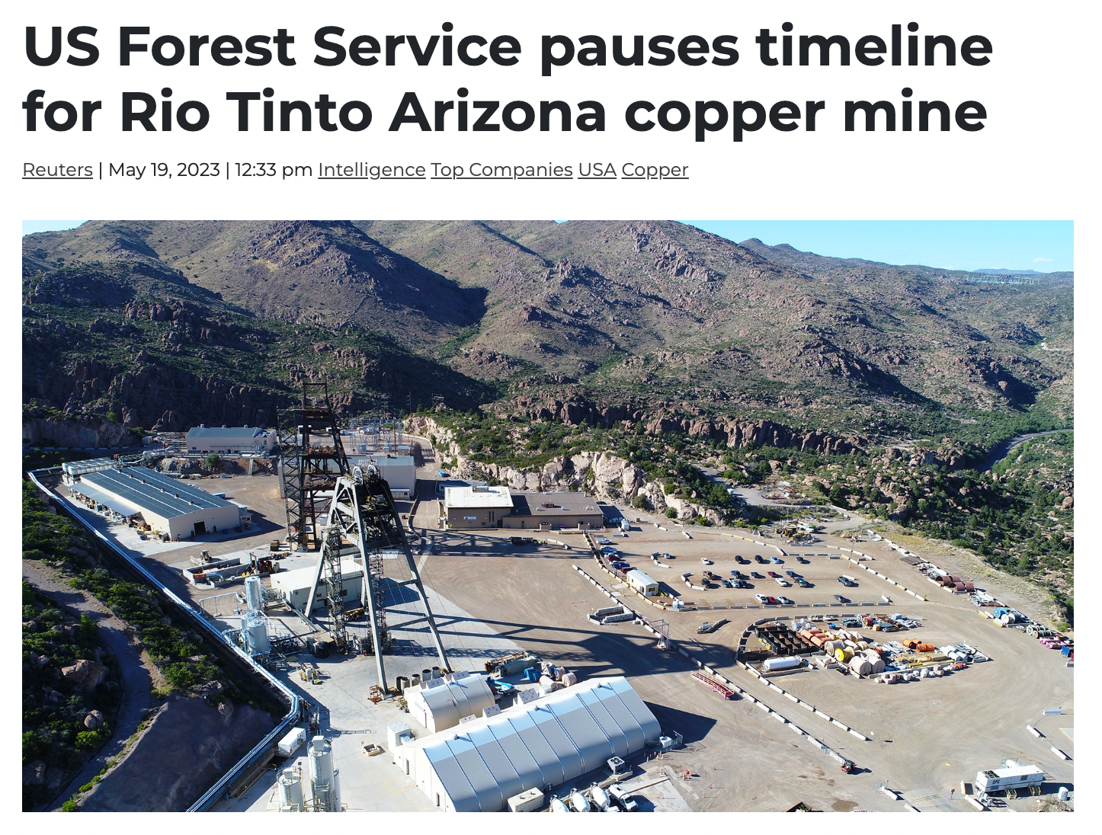
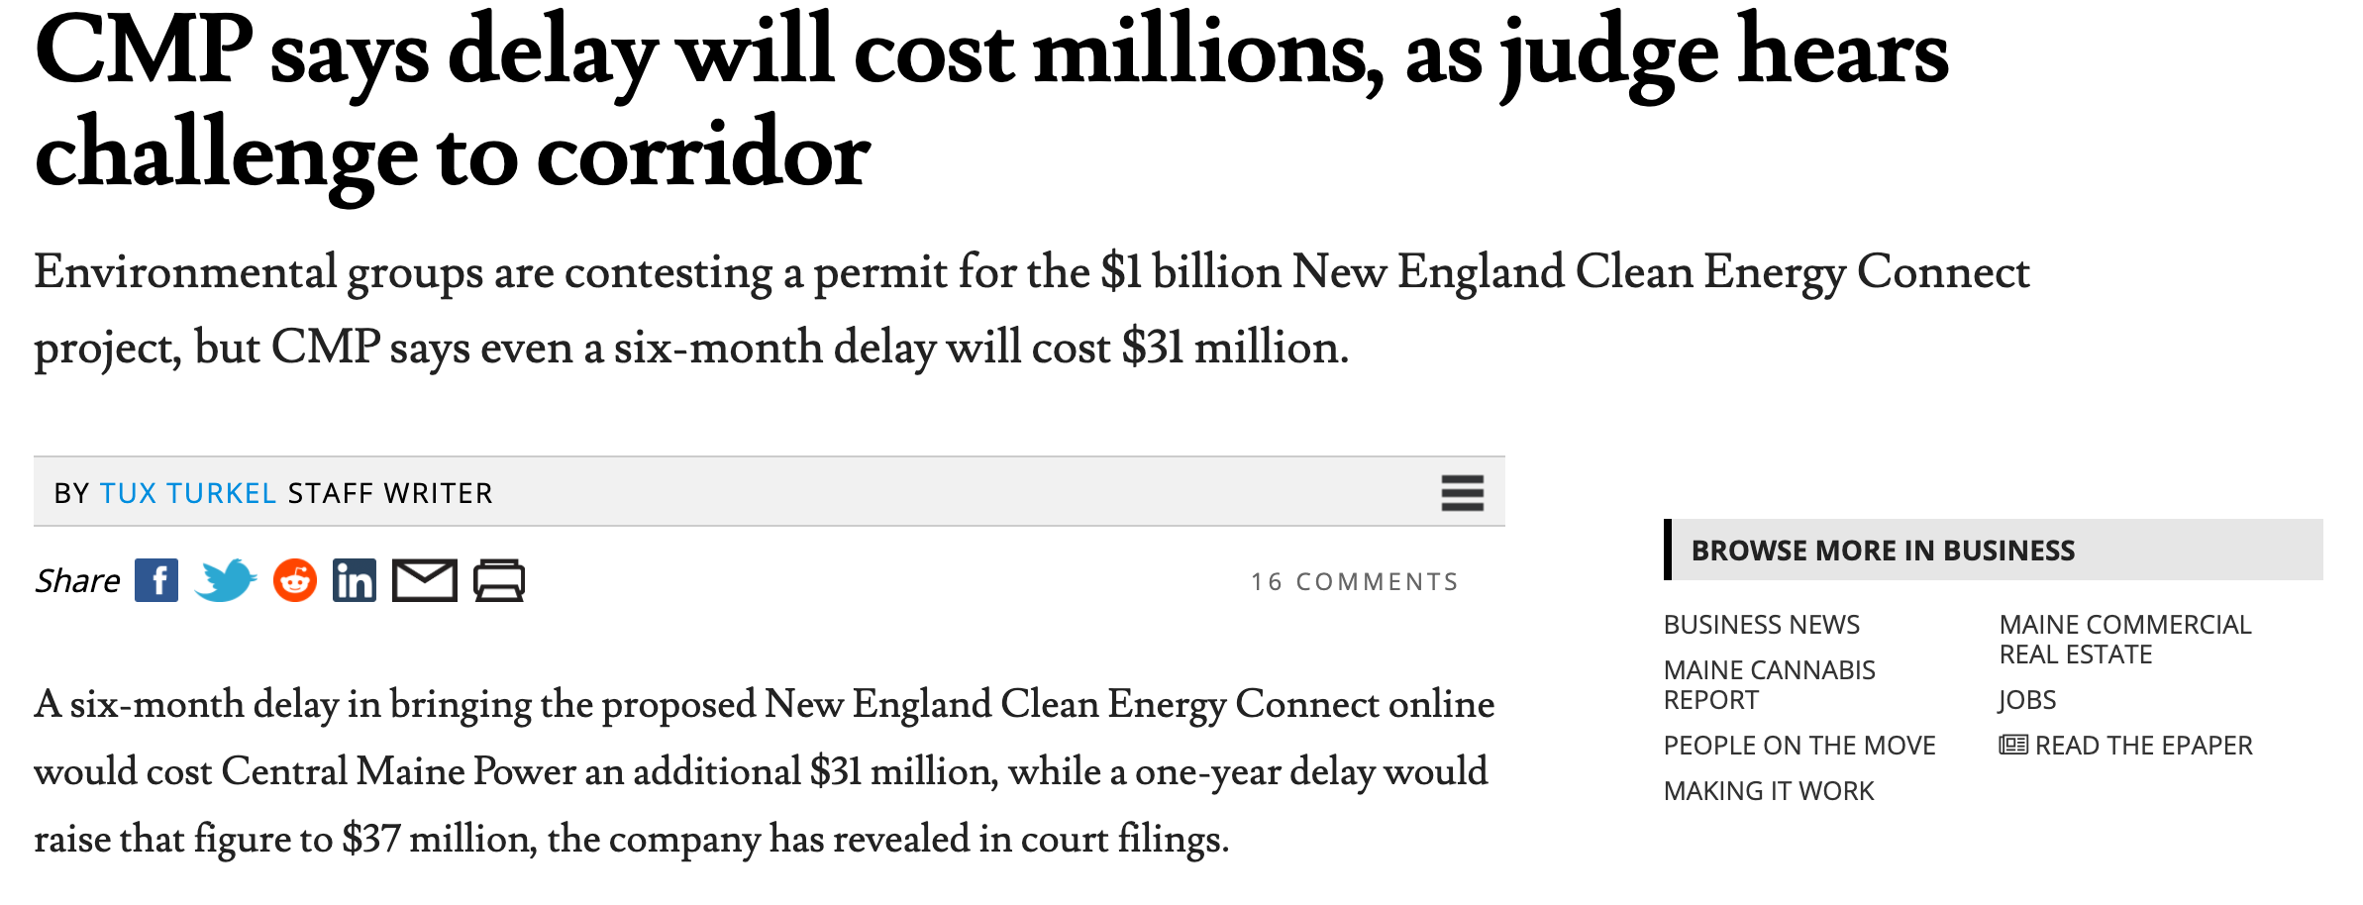

Slide 21
Proposals to Speed Permitting
Senator Manchin’s Proposal:
Federal permits for powerlines & hydrogen pipelines
*Time guidelines for environmental reviews
*Permits to Mountain Valley Pipeline, end judicial review
*Part of debt limit agreement
BUILDER Act
Courts can’t stop projects for more environmental review
States can’t stop federally approved projects

Slide 22
Prof. James W. Coleman
Blog: Twitter & YouTube: Interviews: | EnergyLawProf.com @EnergyLawProf EnergyTradeoffs.com
Slides available: https://bit.ly/BuildingOurEnergyFuture

